Slide 1
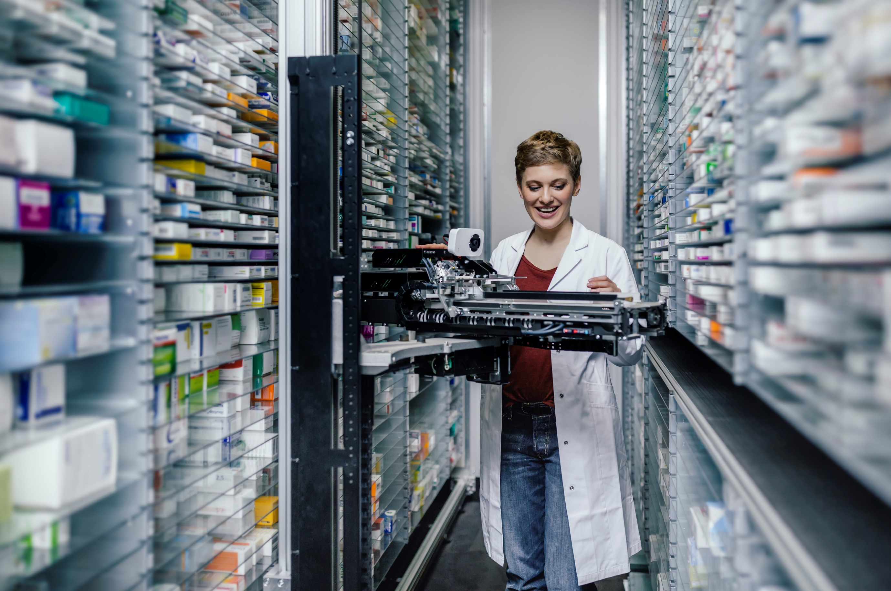

Cognitive Pharmacy
Team Name: SS_Incredible
Participants Name: John Eappen, Prafful Jha

Slide 2








PROBLEM
STATEMENT
One of the biggest challenges of the health care system in our country is the elevated drug prices which are often out of reach for economic middle and lower class people.
A survey conducted by a known agency states that people are paying around 50% to 200% higher rates (MRP) for medicines at local pharmacy stores as compared to the actual market price.
They further added that Doctors are prescribing medicines of the company they have a tie up with to gain monetary benefits.
During this pandemic we have seen an unprecedented rise in the MRP for generic medicines which has created chaos across the country.

Slide 3


THE
SOLUTION
Creating a digital solution (Web application) which will detect the generic name of the medicine being prescribed by a Doctor. By using the generic name along with chemical composition, the application will further extract various options available in the market which have same chemical compositions and CDSCO approval.
The application will not only display the medicine details from different sources but also provide the cost and the link from where it can be purchased online at discounted rates.
The application will also provide the details of the generic stores and Pradhan Mantri Jan Aushadhi stores near by, if the medicines are available in these stores along with the price tag.
Note: The term ‘Generic medicine ’ refers to the chemical makeup of a drug rather than to the advertised brand name under which the drug is sold.
Note: ‘Generic stores ’ and Pradhan Mantri Jan Aushadhi stores sells generic drugs which are copies of brand-name drugs that have exactly the same dosage, intended use, effects, side effects, route of administration, risks, safety, and strength as the original drug.

Slide 4
HOW IT WORKS
1st Step
2nd Step
3rd Step
4th Step
Consumer has to input the medicine name in the Web application.
The Application will then retrieve the generic name and chemical compositions of the medicine in the background and will display multiple medicine options from different brands along with their price.
URL link of various online pharmacies will be available in the application through which consumer can buy the medicines online by just clicking on the link post comparing the rates.
Medicine details along with contact details of Generic stores will be displayed in the application which are located near by to the user.

Slide 5


TECHNOLOGIES USED
AARI
AA BOT/Control Room
A web application has been designed to input the name of the drug along with Salt, prescribed by the doctor. The application further displays the details of same drug from other brands.
A BOT workflow is created in Automation Anywhere which will perform the end to end activity in the background. It will be triggered via control room as soon as the web application is updated by an user.
REST API
SQL DATABASE
Rest API has been used to fetch data from different sources which extracts the drug details along with the pricing and URL link from where consumers can buy the medicines online.
SQL database has been integrated with UiPath Platform and is used to store the drug details along with their Generic name.

Slide 6


BENEFITS
Ease of Access
Saves Customer’s Money
Improved Customer Experience
Less Time Consuming
Multiple Medicine Options

Slide 7
Source code:
The Source code can be accessed via the Github link:
https://github.com/johneay/Cognitive-Pharmacy_AA

Slide 8
Thank You
RPACOE@SOPRASTERIA.COM

